Slide 1
CPT-S 415
Big Data
Yinghui Wu
EME B45

Slide 2

Why approximate query processing
Information
Systems
“Big Data”
Query
Exact Answer
Long Response Times!
Exact answers NOT always required
  Aggregate queries: precision to “last decimal” not needed
    e.g., “What percentage of the US sales are in NJ?” (display as bar graph)
  Preview answers while waiting. Trial queries
  Base data can be remote or unavailable: approximate processing using locally-cached data synopses

Slide 3
CPT-S 415
Big Data
Approximate query processing
Overview
Query-driven approximation
  case study: graph pattern matching
Data-driven approximation (next lecture)
  Histogram, Sampling, Wavelet, Sketches
  View-based evaluation (next next lecture)
Notes:
Object.

Slide 4
Approximate query processing: overview

Slide 5
Case 1: Approximate Aggregation
Aggregate Queries
Goal is to quickly report the leading digits of answers
  In seconds instead of minutes or hours
  Most useful if can provide error guarantees
  E.g., Average salary
  $59,000 +/- $500 (with 95% confidence) in 10 seconds
    vs. $59,152.25 in 10 minutes
Achieved by answering the query based on samples or other synopses of the data
Speed-up obtained because synopses are orders of magnitude smaller than the original data

Slide 6



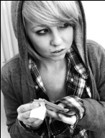

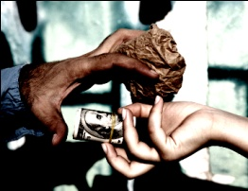
Case 2: Pattern Matching in Social Graphs
Find all matches of a pattern in a graph
Identify suspects
in a drug ring
B
B
A₁
A_{m}
AM
S
W
W
W
W
W
W
FW
W
W
“Understanding the structure of drug trafficking organizations”
Notes:
function-based matching may still be restrictive especially in searching organizations and groups;
Identical labelling or similarity labelling could be restrictive;
In a nutshell, the pattern matching is to identify all the matches – these matches may not necessarily be isomorphic to the pattern! Also as illustrated by the previous slides.

Slide 7

Make case for computationally efficient queries
Approximate query answering
  Query-driven approximation
    Rewrite queries to computationally efficient query classes
  Data-driven approximation
    Compact Data Synopses, materialized views, compression, summaries, sketches, spanners..
    resource-bounded query answering
“Big Data”
Exact Query
Exact Answer
Long Response
Times!
Data Driven:
Data synopsis
Compression,
Sampling..
Views
“Small Data”
Query Driven:
Approximate
Query
Approximate Answer
FAST!!
KB/MB

Slide 8
Query-driven approximation:
graph pattern matching

Slide 9
Graph Pattern Matching
Definition
  Input: a pattern graph P, a data graph G, matching semantics
  Output: correspondence from P to G
    matching relation/function
    matched noes/edges/subgraphs
A “special case” of general graph matching. Difference? semantic of P (as a graph or a pattern)
Variants of graph (pattern) matching
  small pattern vs. large graph matching
  single data graph vs. multiple graphs
  rich semantics vs. simple label equality
  flexible matching semantics vs. strict matching functions
  approximate matching vs. exact alignment

Slide 10
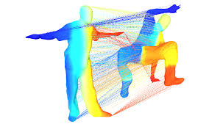
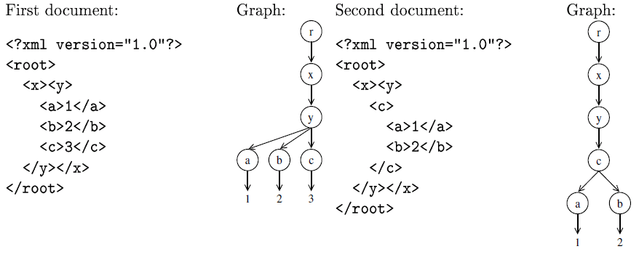
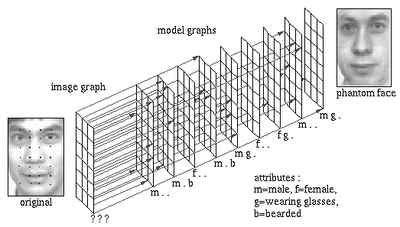
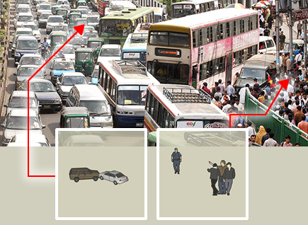
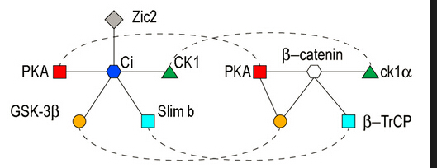
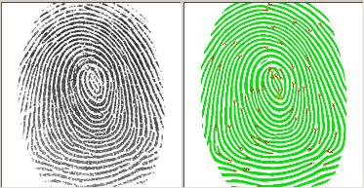
Graph Pattern Matching: Manifold application areas
  2D and 3D image analysis
  Document processing
  Video analysis
  Biological and
  biomedical applications
  Biometric identification

Slide 11
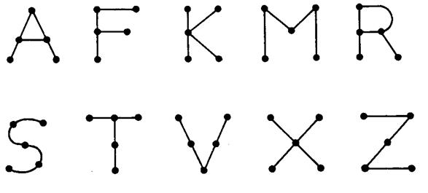
Subgraph isomorphism
A function f from the nodes of Q to the nodes of G:
For each node u in Q, u and f(u) have the same label;
There exists an edge (u, u’) in Q if and only if there exists an edge (f(u), f(u’)) in G
A
A
B
B
B
Isomorphism: [A, R], [F,T],[M,S]
v₁
v₂
D
E
D
E
Q
G
A bijection: identical label matching, edge-to-edge relations
Notes:
QSX Spring 2004 (LN5)

Slide 12
Matching by subgraph isomorphism
Input: A directed graph G, and a graph pattern Q
Output: all subgraphs of G that are isomorphic to Q
NP-complete
Exponentially many matches
Complexity
  Remains NP-hard even when
    Q is a forest and G is a tree
    Q is a tree and G is acyclic
PTIME if Q is a tree and G is a forest
intractable

Slide 13
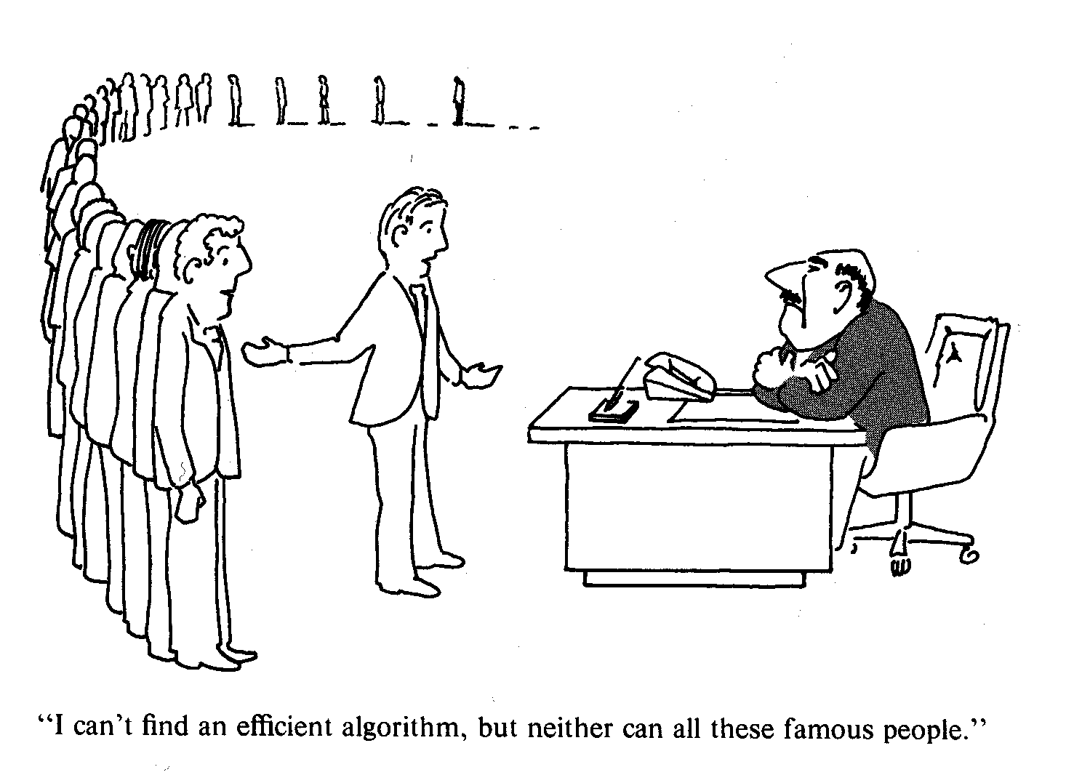
NP-completeness

Slide 14
Algorithms for computing subgraph isomorphism
Input: pattern Q and graph G
Output: all isomorphic mappings P from Q to G
P: partial mappings, initially empty
Match(P)
if P covers all nodes in Q then output P;
else compute the set S(P) of all candidate pairs for inclusion in P
for each pair p = (u, v) in S(P)
  if p passes feasibility check
  then P’ ← P ∪ {p}; call Match(P’);
restore data structures
nodes that are directly connected to those already in P, with the same labels
Guarantee correctness
for each pair p = (u, v) in S(P):
enumerate all possible extensions, for refinement
if the feasibility test is not successful, drop it and try the next
Recursion, refinement

Slide 15
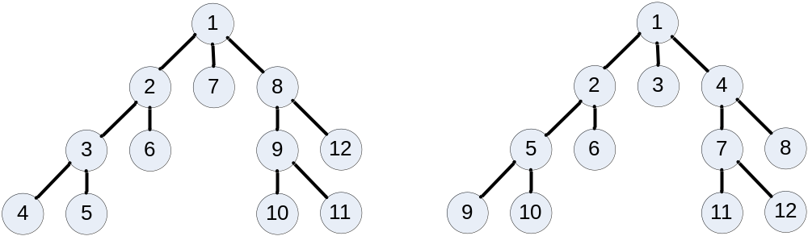
Backtracking for isomorphism test
The backtracking algorithm
  depth-first search(DFS): expanding the first child node of the search tree; going deeper until a goal node is found, or until it hits a node that has no children.
  Branch and bound(B&B): BFS(breadth-first search)-like search for the optimal solution. Branch is that a set of solution candidates is splitted into two or more smaller sets; bound is that a procedure upper and lower bounds.
Notes:
What are the benefits/pros and cons for these methods? Any-time/top-k vs parallel processing

Slide 16
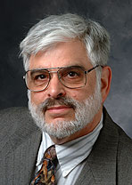
Ullman’s algorithm
Use adjacency matrices of G and Q, their transposes, and a form of permutation matrices
Backtrack(P)
if P covers all nodes in Q then output P and return;
for each node u in Q that is not yet in P
  find a node v in G; p ’ ← (u, v); P’ ← P ∪ {p};
  if P’ makes a partial mapping (injective function, preserving edges)
  then call Backtrack(P’);
Expanding permutation matrices representing P
for each candidate pair p = (u, v):
enumerate all possible extensions, for refinement
Backtracking: no matter whether the test is successful or not, go back to the previous level and try another p
J. R. Ullman. An Algorithm for Subgraph Isomorphism. JACM 1976
An algorithm that is still being used

Slide 17
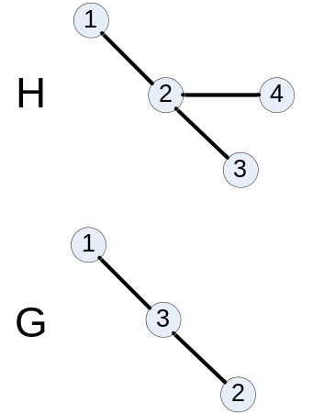
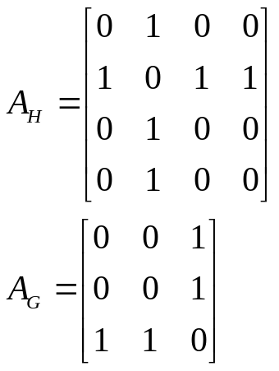
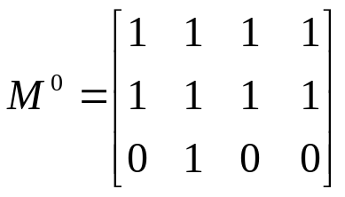
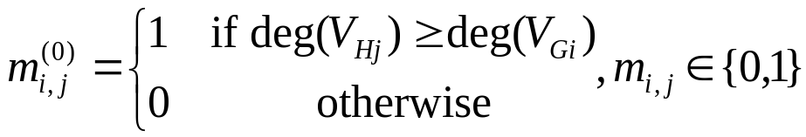
Ullman’s algorithm
  Input: graphs Q and G with their adjacency matrix A_{Q} and A_{G}
  A refinement procedure based on matrix of possible future matched node pairs to prune unfruitful matches
  The enumeration algorithm for the isomorphisms between a graph Q and a subgraph of another graph G with the adjacency matrices A_{Q} and A_{G}
G
a permutation matrix
A_{G}
Q
A_{Q}
deg(V_{Gj}) >= deg(V_{Qj})

Slide 18
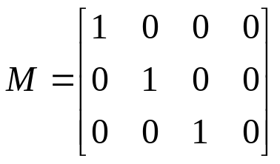

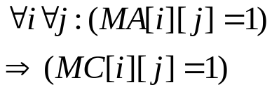
Ullman’s algorithm: Matrix M’
M’[i][j] = 1 means that the j-th vertex in G corresponds to i-th vertex in query Q;
Each row in M’ contains exactly one 1;
No column contains more than one 1.
M’ specifies an subgraph isomorphism from Q to G.
Given two graphs Q and G, their corresponding matrixes are MA_{n×n}=[a_{ij}] and MB_{m×m} = [b_{ij}].
Goal: 1) Find matrix M’ _{n×m} such that
2) or report no such marix M’.
find M’ s.t.
G
Q

Slide 19
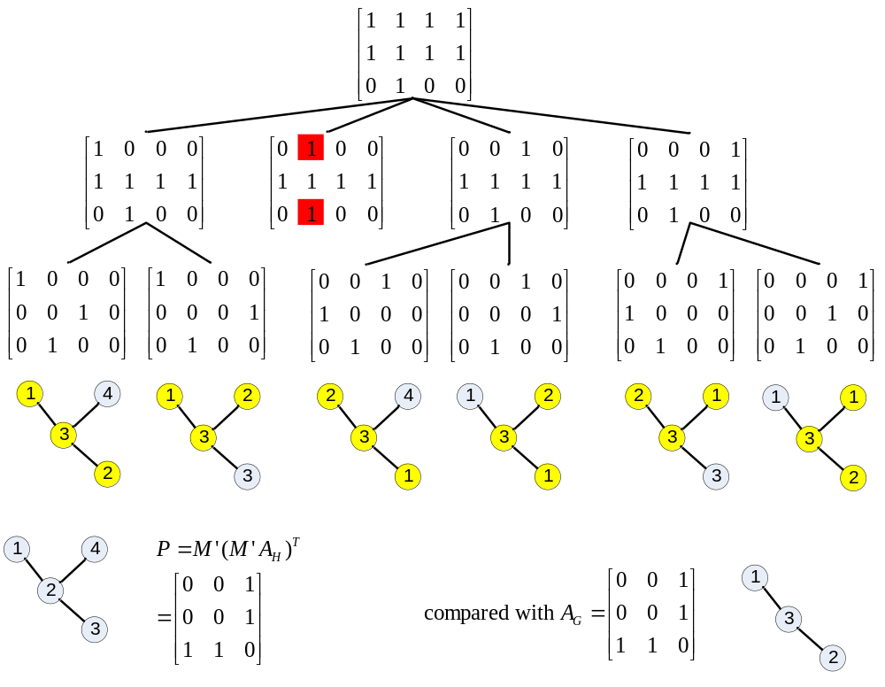
Ullmann’s algorithm
Step 1. Set up matrix M_{n×m}
Step 2. iteratively change
1 to 0 subject to M’; maximum
depth: |Q|
Step 3. verify.
Notes:
In meinem Vortrag werde ich zunächst....

Slide 20
VF2
Match(P)
if P covers all nodes in Q then output P;
else compute the set S(P) of all candidate pairs for inclusion in P
for each pair p = (u, v) in S(P)
  if p passes feasibility check
  then P’ ← P ∪ {p}; call Match(P’);
restore data structures
Five k-look-ahead rules, to make sure that P is a partial isomorphic mapping
Guarantee correctness and reduce backtracking
Feasibility rules: for each pair (u, v) in P
their predecessors are already mapped and included in P
their successors can possibly be mapped
Certain conditions on cardinalities of predecessors and successors to ensure correctness and expandability
L. P. Cordella, P. Foggia, C. Sansone, M. Vento. A (Sub)Graph Isomorphism Algorithm for Matching Large Graphs, IEEE Trans. Pattern Anal. Mach. Intell. 26, 2004
VF2: a popular algorithm for subgraph isomorphism

Slide 21

VF2
Considering two graphs Q and G, the (sub)graph isomorphism from Q to G is expressed as the set of pairs (n,m) (with n Q, m G)
Idea: finding the (sub)graph isomorphism between Q and G is a sequence of state transition.
an intermediate state s denotes a partial mapping from Q to G
1
(1, 1)
(2, 2)
(3, 3)
(1, 4)
(2, 2)
(3, 3)
1
A
A
2
3
 | Intermediate States
s1 | (2,2)
s2 | (2,2) (1,1)
s3 | (2,2)(1,1)(3,3)
2
3
B
C
B
C
4
A

Slide 22
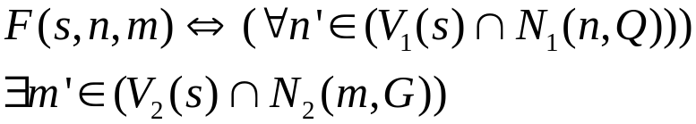
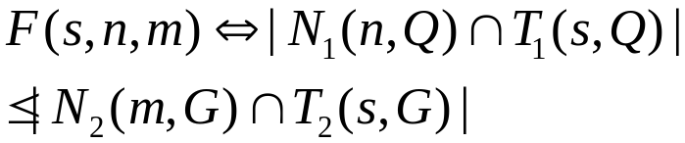
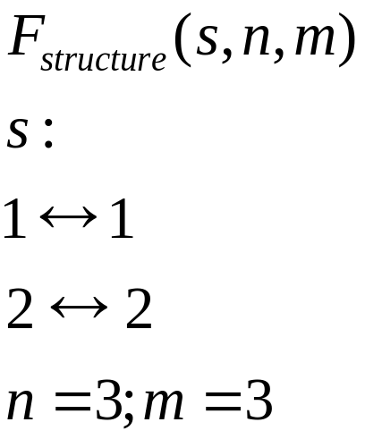
Some Structural Feasibility Rules
Neighbor Connection
1
A
1
A
2
3
B
C
2
3
B
C
4
A

Slide 23
Approximate graph pattern matching:
from intractability to PTIME

Slide 24
Pattern Matching in Social Graphs
Find all matches of a pattern in a graph
Identify suspects
in a drug ring
B
B
A₁
A_{m}
AM
S
W
W
W
W
W
W
FW
pattern graph
W
W
“Understanding the structure of drug trafficking organizations”
Notes:
function-based matching may still be restrictive especially in searching organizations and groups;
Identical labelling or similarity labelling could be restrictive;
In a nutshell, the pattern matching is to identify all the matches – these matches may not necessarily be isomorphic to the pattern! Also as illustrated by the previous slides.

Slide 25



Pattern Matching in Social Graphs
not allowed by bijection
relation instead of function
B
A₁
B
A_{m}
1
AM
S
W
W
W
W
W
W
FW
W
W
The quest for a new form of graph pattern matching

Slide 26
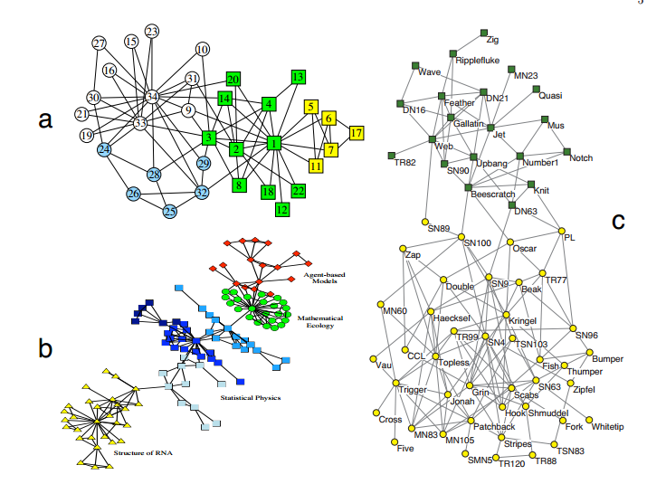
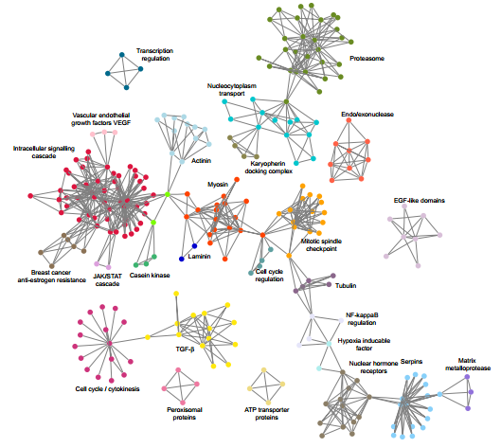
Community and social role detection
Positions: actors that show similar structure of relationships
Roles: pattern of relationships of members of same or different positions
“Role equivalence”: two positions are considered as similar, if every important aspect of the observed structure applies (or does not apply) for both positions

Slide 27
Graph Simulation
A binary relation R on the nodes of Q and the nodes of G:
For each node u in Q, there exists a node v in G such that (u, v) is in R, and u and v have the same label;
If there exists an edge (u, u’) in Q and each pair (u, v) is in R, then there exists an edge (v, v’) in G such that (u’, v’) is in R
A
A
B
B
B
v₁
v₂
D
E
D
E
relations as opposed to functions
Q
G
A relation: label matching, edge-to-edge mapping
Notes:
QSX Spring 2004 (LN5)

Slide 28
Subgraph isomorphism vs Graph Simulation
Node label equivalence vs node search constraints
Bijective function vs. many-many relation
A
A
E
D
E
D
B
B
B
v₁
v₂
B
B
v₁
B
v₂
D
E
D
E
A
A
P
G
P
G
Identical label matching, edge-to-edge function/relations

Slide 29
Matching by graph simulation
Input: A directed graph G, and a graph pattern Q
Output: the maximum simulation relation R
Maximum simulation relation: always exists and is unique
  If a match relation exists, then there exists a maximum one
  Otherwise, it is the empty set – still maximum
  Complexity: O((| V | + | V_{Q} |) (| E | + | E_{Q}| )
  The output is a unique relation, possibly of size |Q||V|
Use relations instead of functions
Quadratic time

Slide 30
Algorithm for computing graph simulation
Input: pattern Q and graph G
Output: for each u in Q, sim(u): the matches w in G
Similarity(P)
for all nodes u in Q do
  sim(u) ← the set of candidate matches w in G;
while there exist (u, v) in Q and w in sim(u) (in G) that violate the simulation condition
  sim(u) ← sim(u) − {w};
output sim(u) for all u in Q
with the same label; moreover, if u has an outgoing edge, so does w
successor(w) ∩ sim(v) = ∅
refinement
successor(w) ∩ sim(v) = ∅
There exists an edge from u to v in Q, but the candidate w of u has no corresponding edge to a node w’ that matches v

Slide 31
Approximate graph pattern matching for social network analysis

Slide 32


Pattern matching in social graphs
not allowed by bijection
relation instead of function
B
A₁
B
A_{m}
AM
S
W
W
W
W
W
W
FW
edges to paths
W
W
For both scalability and effectiveness
Neither subgraph isomorphism nor graph simulation works

Slide 33
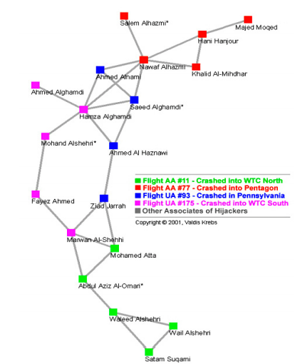
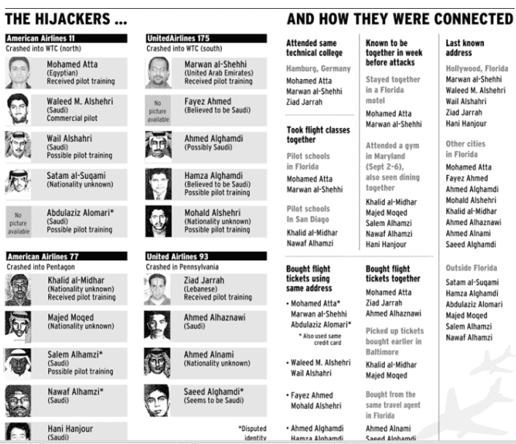
Trusted Contacts in 911 Terrorist network
“Those who were trained to fly didn’t know the others. One group of people did not know the other group”
- Bin Laden, 2001

Slide 34

Bounded patterns
Search condition
Pattern graph: Q = (V_{Q}, E_{Q}, f_{v}, f_{e})
f_{v}(u): a conjunction of A op a, op in <, ≤, =, ≠, >, ≥
f_{e}(u,u’): a constant k or a symbol ∗, bound
within k hops
Med
Bounded
*
Unbounded
3
*
CS
2
Bio
f_{v}(): ‘dept’=CS
3
2
Soc
Incorporating search conditions and bounds on the number of hops

Slide 35



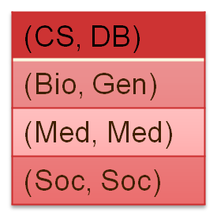












Bounded Simulation
for each (u,v)∈ S,
  attributes f_{A}(v) satisfies predicate f_{v}(u)
  each (u,u’ ) in E_{Q} is mapped to a path from v to v’ of length f_{e}(u,u’ ) in G, (u’,v’ )∈ S
G = (V, E, f_{A}) matches Q = (V_{Q}, E_{Q}, f_{v}, f_{e}) via bounded simulation, if there exists a binary relation S ⊆ V_{Q} × V such that S
is a total mapping,
satisfies search conditions and bounds on edge-to-path mappings
for each u∈ V_{Q}, there exists v∈ V such that (u,v)∈ S
match
Med
AI
Med
*
3
*
CS
Bio
DB
Gen
Chem
2
3
2
Soc
There exists a unique maximum match
Soc
Eco
Mapping edges to bounded paths

Slide 36

Bounded simulation in social graphs
relation instead of function
B
A₁
B
A_{m}
1
AM
S
W
W
W
3
3
W
W
W
FW
edges to paths
W
W
The set of all suspects involved in a drug ring

Slide 37
Complexity
Input: Pattern Q and data graph G
Output: Q(G), the unique maximum match relation
O(| V | | E | + | E_{Q}| | V |² + | V_{Q}| | V |)
Subgraph isomorphism: intractable
Graph simulation: O((| V | + | V_{Q} |) (| E | + | E_{Q}| )
Query driven approximation: use bounded simulation instead of subgraph isomorphism. Criteria:
Lower complexity
Effectiveness: the query answers are sensible
Algorithm? The reading list
To identify sensible matches and be computable in low PTIME

Slide 38
Bounded simulation vs. graph simulation
Graph simulation: a special case of bounded simulation
The same bound 1 on all pattern edges (edge-to-edge mapping)
Unique attributes vs. search conditions: label equality
O((| V_{G} | + | V_{Q} |) (| E_{G} | + | E_{Q}| )
vs.
O(| V_{G} | | E_{G} | + | E_{Q}| | V_{G} |² + | V_{Q}| | V_{G}|)
Process calculus
Web site classification
Social position detection, …
Capture more sensible matches in social graphs (by 80%)

Slide 39
Approximate graph pattern matching:
Incorporating edge relationships

Slide 40







Edge relationships
S: supervise
C: co-author
S
S
C
C
Mat, DB
Ann, CS
John, DB
C
S⁺
S
CS
C
C
Bill, Bio
Tom, Bio
C
DB
C
Bio
C
Pat, DB
Don, Gen
Bio
What is this pattern to find?
Notes:
We first use this example to illustrating the different matching method

Slide 41




Edge relation
Facebook
Mikhail
Twitter
Alice
Sunita
Jose
(Alice, Facebook)
(Alice, Sunita)
(Jose, Twitter)
(Jose, Sunita)
(Mikhail, Facebook)
(Mikhail, Twitter)
(Sunita, Facebook)
(Sunita, Alice)
(Sunita, Jose)

Slide 42
Graph encodings: Adding edge types
Facebook
fan-of
fan-of
fan-of
Mikhail
fan-of
fan-of
Twitter
friend-of
friend-of
Alice
Sunita
Jose
(Alice, fan-of, Facebook)
(Alice, friend-of, Sunita)
(Jose, fan-of, Twitter)
(Jose, friend-of, Sunita)
(Mikhail, fan-of, Facebook)
(Mikhail, fan-of, Twitter)
(Sunita, fan-of, Facebook)
(Sunita, friend-of, Alice)
(Sunita, friend-of, Jose)
Adding edge labels

Slide 43

Graph encodings: Adding weights
Facebook
fan-of
fan-of
fan-of
0.8
Mikhail
0.7
0.5
0.7
fan-of
fan-of
Twitter
friend-of
friend-of
0.3
0.5
Alice
0.9
Sunita
Jose
(Alice, fan-of, 0.5, Facebook)
(Alice, friend-of, 0.9, Sunita)
(Jose, fan-of, 0.5, Twitter)
(Jose, friend-of, 0.3, Sunita)
(Mikhail, fan-of, 0.8, Facebook)
(Mikhail, fan-of, 0.7, Twitter)
(Sunita, fan-of, 0.7, Facebook)
(Sunita, friend-of, 0.9, Alice)
(Sunita, friend-of, 0.3, Jose)
Even further, you can add weights and others

Slide 44

Regular patterns
Pattern: Q = (V_{Q}, E_{Q}, f_{v}, f_{e})
f_{v}(u): a conjunction of A op a, op in <, ≤, =, ≠, >, ≥
f_{e}(u,u’ ): a regular expression of the form
F ::= c | c^{≤k} | c⁺ | FF
C
S⁺
CS
Simple regular expressions:
fairly common
low complexity in matching
DB
Bio
C
Bio
Mapping edges to paths satisfying associated regular expressions

Slide 45
Complexity
Input: Pattern Q and data graph G
Output: Q(G)
m: the number of distinct colors in Q
O(| V | | E | + m | E_{Q}| | V |² + | V_{Q}| | V |)
bounded simulation: a special case
  single color c (hence m = 1)
  f_{e}(u,u’ ) = c
general regular expressions?
Adding edge colors does not incur extra complexity

Slide 46
Graph pattern matching:
Capturing graph topology

Slide 47
Limitations of graph simulation
pattern
graph
A disconnected graph matches a connected pattern
The yellow node in the pattern has 3 “parents”, in contrast to 1 in the data graph
An undirected cycle matches a tree
Simulation does not preserve the topology well in matching
Notes:
QSX Spring 2004 (LN5)
Nan Tang: in the takeaway message, I won’t use two “application” s, you can use “Wide employed, used, etc”

Slide 48
Limitations of graph simulation
pattern
graph
A cycle with two nodes matches a cycle of unbounded length
The match relation may be excessively large
When social distances increase, the closeness of relationships decrease
The need for revising simulation to enforce locality
Notes:
QSX Spring 2004 (LN5)
Nan Tang: in the takeaway message, I won’t use two “application” s, you can use “Wide employed, used, etc”

Slide 49
Dual simulation
G = (V, E, f_{A}) matches Q = (V_{Q}, E_{Q}, f_{v}, f_{e}) via dual simulation, if there exists a binary relation S ⊆ V_{Q} × V such that S
is a total mapping,
satisfies search conditions, and
preserves both “child” and “parent” relationships
Q(G) : a unique maximum match relation
Preserve “parent” relationships and connectivity

Slide 50
Locality
diameter d_{Q}: the maximum shortest distance (undirected paths)
2
1
d_{Q}-radius subgraph G[v, d_{Q}] : centered at v, within d_{Q} hops
v
Excessive match
Locality: matches contained in G[v, d_{Q}] for some v

Slide 51
Strong simulation
G matches Q via strong simulation, if there exists a node v in G such that G[v, d_{Q}] matches Q via dual simulation
  duality
  local
Match: the subgraph G_{S} of G[v, d_{Q}] representing the maximum match S
Matching: given Q and G, find the set Q(G) of all matches

Slide 52
Preserving the topology of patterns
Child and parent relationships
connectivity: if Q is connected (via undirected path), so is G_{S}
cycles: a directed (resp. undirected) cycle in Q matches a directed (resp. undirected) cycle in G_{S}
bounded matches:
  the diameter of G_{S} is at most 2 * d_{Q}
  |M(Q, G)| ≤ |V|

Slide 53
Strong simulation vs. graph simulation
exact pattern matching
G matches Q via subgraph isomorphism
preserve topology, but not bounded match
G matches Q via strong simulation
does not preserve parents, connectivity, undirected cycles, bounded match
G matches Q via dual simulation
G matches Q via graph simulation
Input: Pattern Q and data graph G
Output: Q(G)
cubic time
O(| V | (| V | + (| V_{Q}| + | E_{Q}|) (| V | + | E |))
A balance between the complexity and the ability to preserve topology

Slide 54
Summing up

Slide 55
Various notions for graph pattern matching
matching | complexity | match size
subgraph isomorphism | NP-complete | |V| ^{|VQ|}
graph simulation | quadratic time | |V| |V_{Q}|
bounded simulation | cubic time | |V| |V_{Q}|
regular matching | cubic time | |V| |V_{Q}|
strong simulation | cubic time | |V|
Query driven approximation: from subgraph isomorphism (intractable) to strong simulation or bounded simulation (cubic-time)

Slide 56
Summary and review
Query-driven approximation
What is subgraph isomorphism? Complexity? Algorithm? Name a few applications
What is graph simulation? Complexity? Understand its algorithm. Name a few applications
Why do we need to revise conventional graph pattern matching for social network analysis? How should we do it? Why?
Understand bounded simulation. Read its algorithm. Complexity?
What is strong simulation? Complexity? Name a few applications in which strong simulation is useful.
Find other revisions of conventional graph pattern matching that are not covered in the lecture.

Slide 57
Papers for you to review
M. R. Henzinger, T. Henzinger, and P. Kopke. Computing simulations on finite and infinite graphs. FOCS, 1995. http://infoscience.epfl.ch/record/99332/files/HenzingerHK95.pdf
  L. P. Cordella, P. Foggia, C. Sansone, M. Vento. A (Sub)Graph Isomorphism Algorithm for Matching Large Graphs, IEEE Trans. Pattern Anal. Mach. Intell. 26, 2004 (search Google scholar)
A. Fard, M. U. Nisar, J. A. Miller, L. Ramaswamy, Distriuted and scalable graph pattern matching: models and algorithms. Int. J. Big Data. http://cobweb.cs.uga.edu/~ar/papers/IJBD_final.pdf
  W. Fan J. Li, S. Ma, and N. Tang, and Y. Wu. Graph pattern matching: From intractable to polynomial time, VLDB, 2010.
  W. Fan, J. Li, S. Ma, N. Tang, and Y. Wu. Adding Regular Expressions to Graph Reachability and Pattern Queries, ICDE 2011.
  S. Ma, Y. Cao, W. Fan, J. Huai, T. Wo: Strong simulation: Capturing topology in graph pattern matching. TODS 39(1): 4, 2014.

